Slide 1
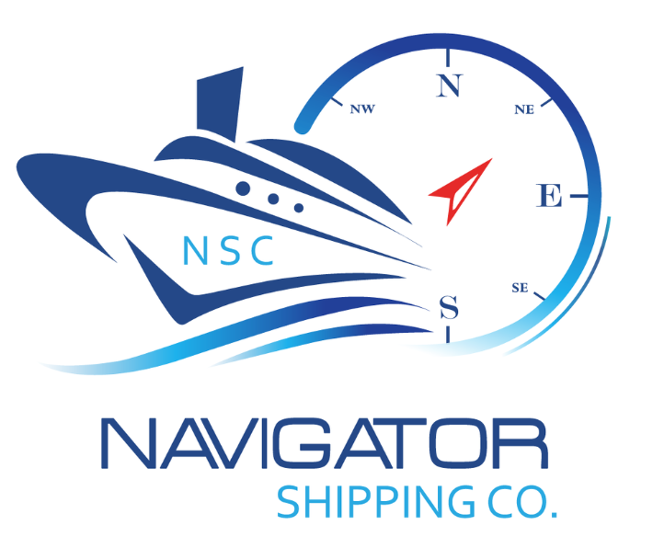
Partner with Navigator Shipping Agency for Maritime Excellence
Your Gateway to Efficient Maritime Logistics in Libya
Website : https://www.navigator.ly
Email : info@navigator.ly

Slide 2
About Navigator Shipping Agency
Navigator Shipping Company (NSC), established in 2011 by Captain Tarek Shokri in Tripoli, specializes in the proficient management of a varied fleet of vessels for a broad spectrum of clients. Our executive team is composed of seasoned experts with a profound understanding of maritime operations. NSC distinguishes itself through its strong connections with Libyan port authorities, which facilitates streamlined and proficient port operations. Our dedication lies in providing outstanding, flexible services tailored to our clients' needs, prioritizing the protection of assets for owners and charterers. This commitment, combined with our competitive stance in the global shipping market, underscores our reputation as a leader in maritime solutions.

Slide 3
Our Services
Efficient Port Operations Management
Stevedoring
Handling
Freight Forwarding
HUB Agent
Protecting Agent
Husbandry Agent
Advanced Logistics and Supply Chain Solutions

Slide 4
Expertise in Libyan Ports
Unmatched Expertise in Libyan Ports
Our in-depth knowledge and hands-on experience in all major Libyan ports position us uniquely to manage complex maritime logistics, ensuring smooth and efficient operations for our clients.
At Navigator Shipping Agency, we pride ourselves on our comprehensive understanding of the local maritime landscape, which includes up-to-date knowledge of port regulations, customs procedures, and the latest operational practices. This expertise allows us to navigate through challenges and provide proactive solutions, significantly reducing turnaround times and enhancing overall efficiency.
Navigator Shipping Agency's Unrivaled Expertise in Libyan Ports

Slide 5
Why Choose Us?
"Why Navigator Shipping Agency?"
Deep-rooted Local Knowledge and Global Standards
"Deep-rooted Local Knowledge and Global Standards"
"Commitment to Safety and Operational Excellence"
"Customized Solutions for Diverse Maritime Needs"
Local Insight, Global Standards:
Expertise in Libyan maritime intricacies paired with international shipping excellence.
Safety and Excellence as Priorities:
Unwavering focus on safeguarding operations and optimizing efficiency.
Tailored Maritime Solutions:
Customized services to meet unique client needs in maritime logistics.

Slide 6
Our Commitment to Safety and Efficiency
"Dedicated to Safety and Efficiency"
"At Navigator Shipping Agency, we prioritize the safety of our operations and cargo. We employ the latest technologies and best practices to ensure high efficiency and reliability in all our services."

Slide 7
Thank you
commercial@navigator.ly
https://www.navigator.ly

